Slide 1
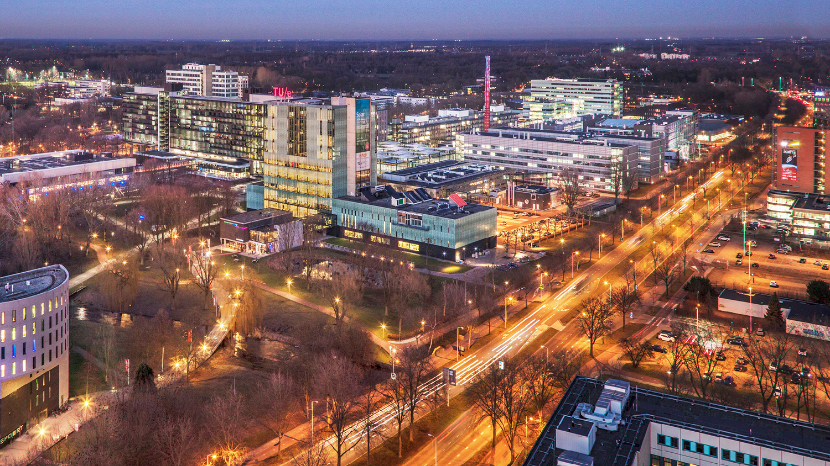
TU/e huisstijl
Wednesday, 10 September 2025
Timo Matray
IC group, Department of Electrical Engineering

Slide 2
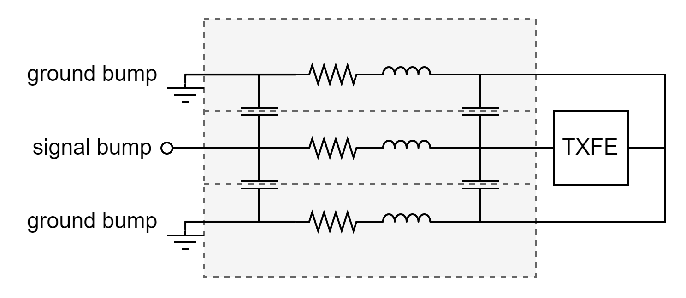
Bump model

Slide 3
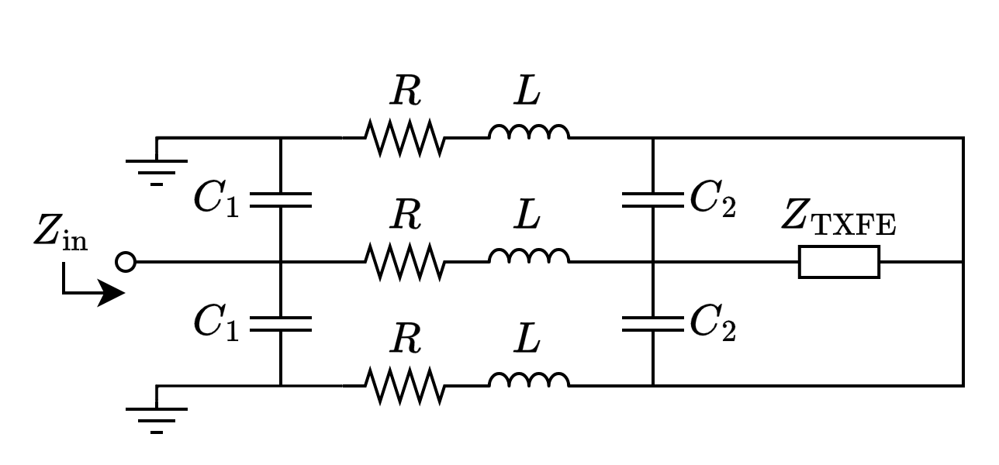

Slide 4
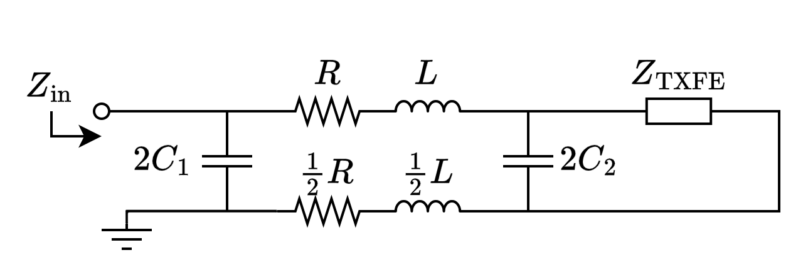
Parallel ground paths

Slide 5
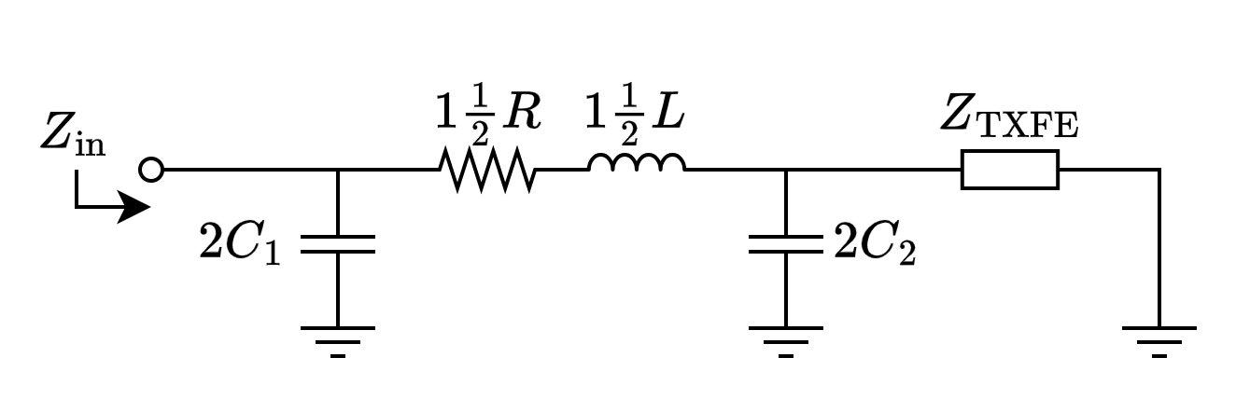
RCL

Slide 6
Impedance fitting

Slide 7
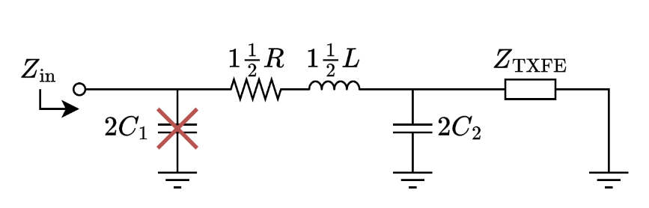
CRL
R = 3.45 Ohm
L = 218 nH
C₂ = 1.04 pF

Slide 8

CRLC
C₁ = 295 fF
R = 3.45 Ohm
L = 179 pH
C₂ = -1.22 pF

Slide 9
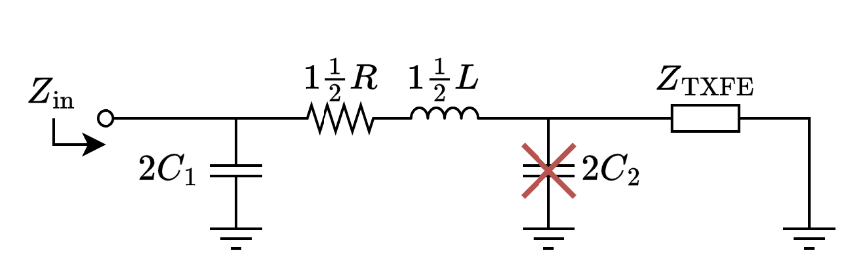
CRL
C₁ = 261 fF
R = 3.45 Ohm
L = 158 pH

Slide 10
CRL (R not fixed)
C₁ = 185 fF
R = 5.53 Ohm
L = 201 pH

Slide 11
CRL
C₁ = 261 fF
R = 3.45 Ohm
L = 158 pH
e_{z,rel,max} = 8.70 Ohm (30.6%)
@ 6.02 GHz
e_{z,abs,max} = 10.3 Ohm (17.8%)
@ 10.0 GHz
e_{z,abs} = 8.80 Ohm
@ 6.23 GHz & 9.89 GHz

Slide 12
S11 fitting

Slide 13
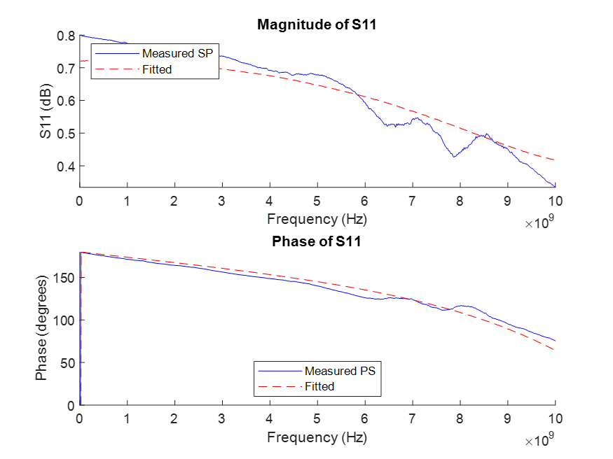

CRL (R not fixed)
Impedance
S11
C₁ = 185 fF
R = 5.16 Ohm
L = 211 pH

Slide 14
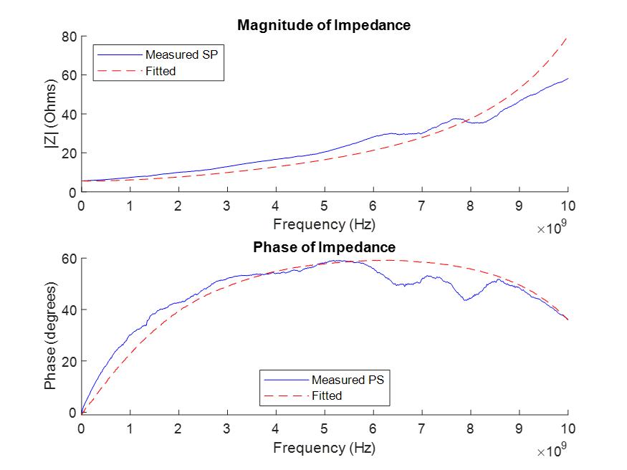
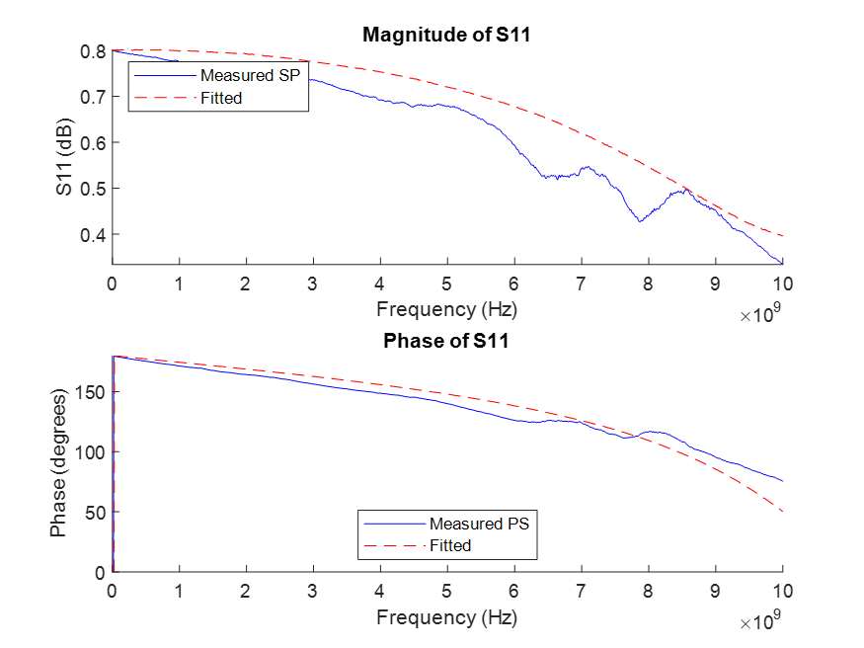
CRL
Impedance
S11
C₁ = 249 fF
R = 3.45 Ohm
L = 178 pH

Slide 15
CRL (optimized up to 5 GHz)
Impedance
S11
C₁ = 249 fF
R = 3.45 Ohm
L = 178 pH

